Slide 1
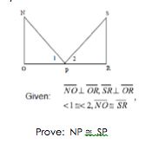
<1 is congruent to <2
Triangle NOP is congruent to triangle SRP
<NOP is congruent to SRP
SP is congruent to NP
NO is congruent to SO
Statements | Reasons
AAS
Perpendicular lines make congruent right angles
CPCTC
given
Given

