Slide 1
MONDAY PROOFS1

Slide 2
Drag and drop the correct reason to match the statements
After you have completed all three, have Mr Willett or the Cat Daddy check your work.
DO NOT SAVE THE FILE

Slide 3
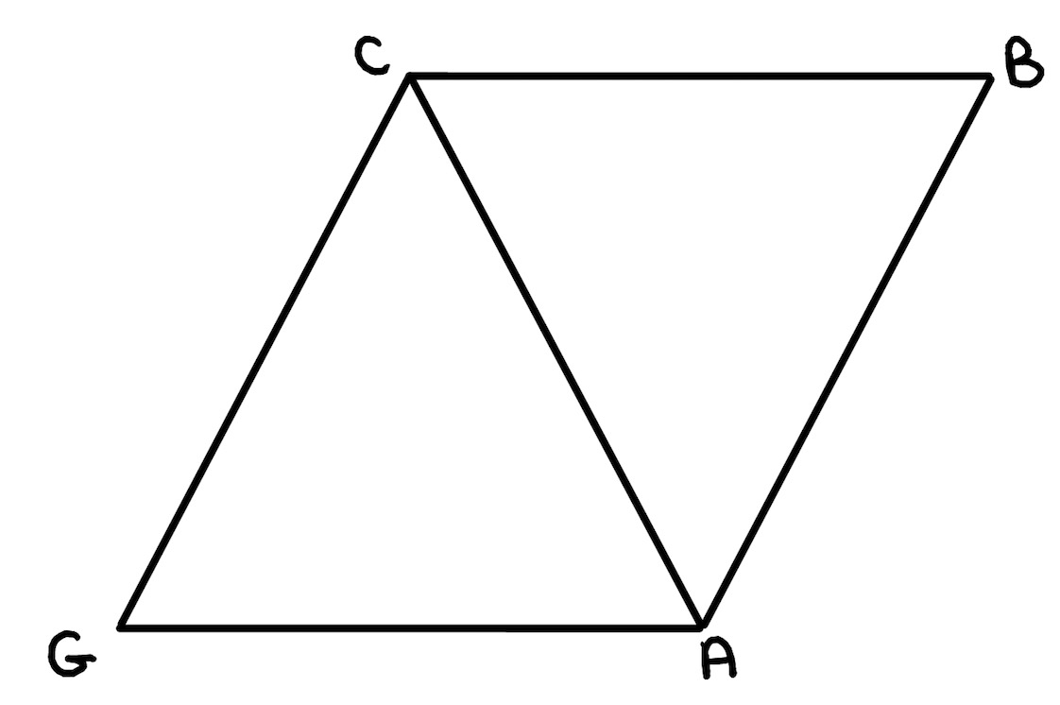
Statements | Reasons
1.
2.
3. CA is congruent to AC
4.
Alternate Interior Angles are Congruent
(FILL IN A STATEMENT)
Given
Shared Side/Reflexive Property
(FILL IN A REASON

Slide 4
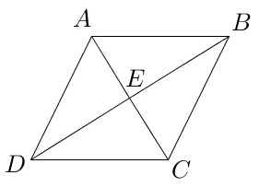
Given: ABCD is a rhombus Prove:
Statements | Reasons
1. ABCD is a rhombus
2.
3.
4.
5.
6.
The diagonals of a rhombus are perpendicular
(WRITE YOUR OWN REASON)
Sides of a rhombus are congruent
HL
Given
The diagonals of a rhombus bisect each other

Slide 5
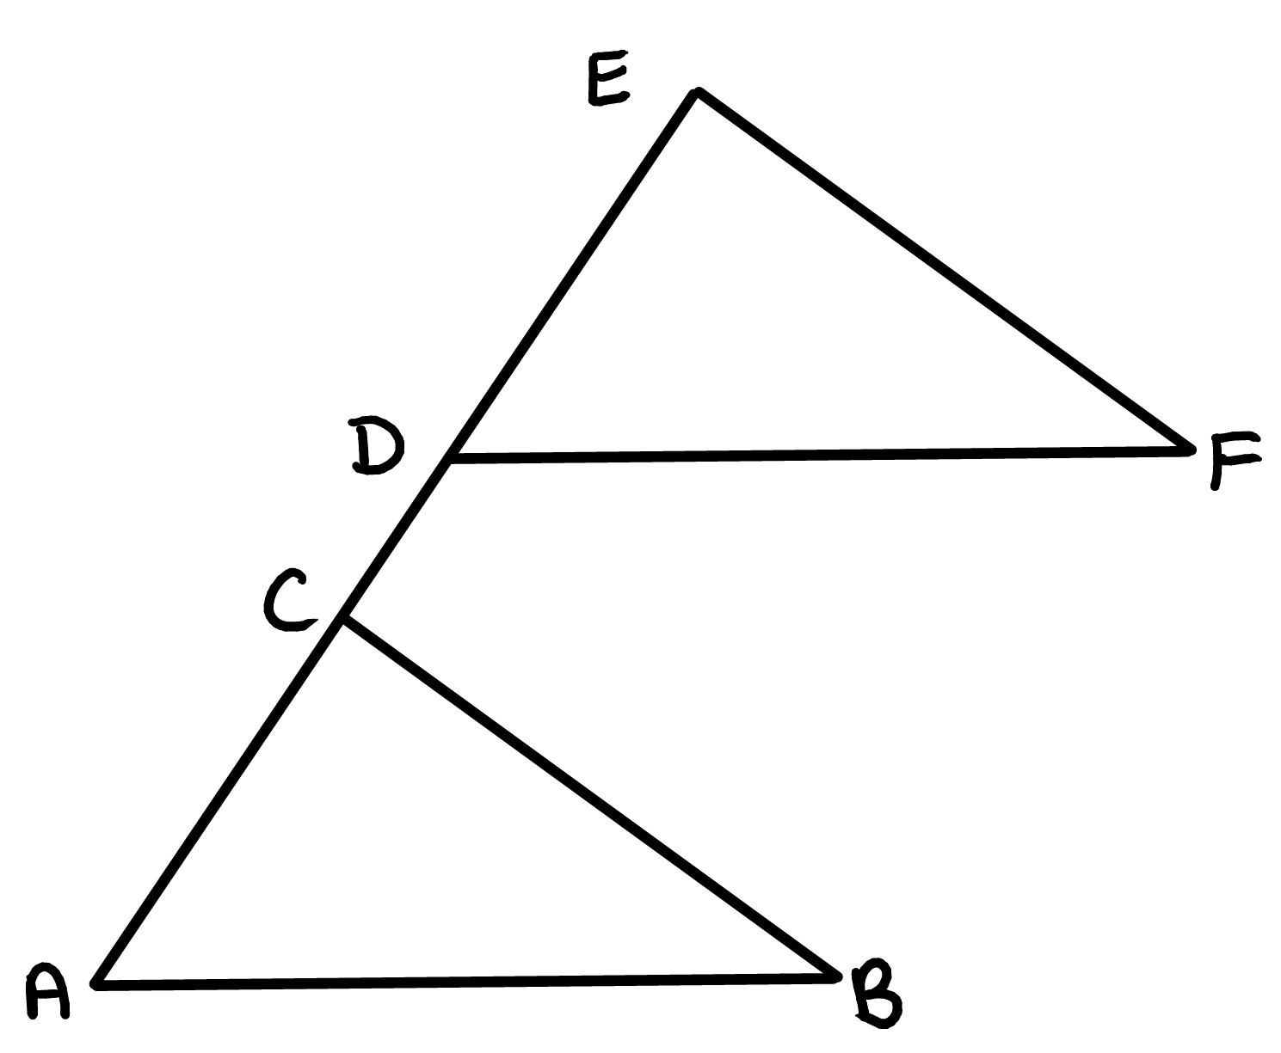
Given:
EF is parallel to CB
AB is parallel to DF
DE is congruent to AC
Prove:
Triangle DEF is congruent to CAB
Statements | Reasons
1. Ef // CB AB // DF DE ≅ AC
2.<EDC ≅ <CAB
3.
4. ΔDEF ≅ ΔCAB
Given
(FILL IN REASON)
(FILL IN STATEMENT)
(FILL IN REASON)
(FILL IN REASON)

