Slide 1
Friday: Drag and drop proofs

Slide 2
Draw the diagram in your notebook
Mark the information on the diagram
Drag and drop the correct reason to match the statements
After you have completed all three, have Mr Willett or the Cat Daddy check your work.
DO NOT SAVE THE FILE

Slide 3
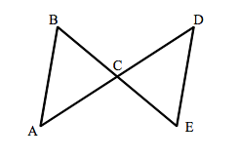
Draw the diagram in your workbook. On the diagram draw all the givens, reflexive or vertical angles from the proof on the following slide

Slide 4
Given:C is the midpoint of BE and <B is congruent to <E
Prove that triangle ABC is congruent to triangle DEC
Statements | Reasons
<E is congruent to <B
2. BC is congruent to EC
3. <ACB is congruent to <DCE
4. Triangle ABC is congruent to DEC
Definition of a midpoint
AAS
Given
ASA
*Write a reason in here*

Slide 5
Draw the diagram in your workbook. On the diagram draw all the givens, reflexive or vertical angles from the proof on the following slide
R
S
T
V

Slide 6
Given that RV is a perpendicular bisector of ST
Prove: That Triangle SRV is congruent to Triangle TRV
R
S
T
Statements | Reasons
RV is a Perpendicular bisector
2. SV is congruent to TV
3. <RVS is congruent to <RVT
4. RV is congruent to RV
5. SRV is Congruent to TRV
V
SAS
Perpendicular lines create congruent right angles
Definition of bisector
Given
Reflexive property/common/shared

Slide 7
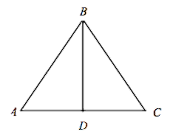
Draw the diagram in your workbook. On the diagram draw all the givens, reflexive or vertical angles from the proof on the following slide

Slide 8
Given: DB is a bisector of angle ABC and AB is congruent to BC
Prove: Triangle ABD is congruent to triangle CBD
Statements | Reasons
1. AB is congruent to BC
2. <ABD is congruent to <CBD
3. BD is congruent to BD
4. Triangle ABD is congruent to Triangle CBD
Definition of an angle Bisector
Reflexive property
Given
HL
SAS

