Slide 1
Drag and drop proofs

Slide 2
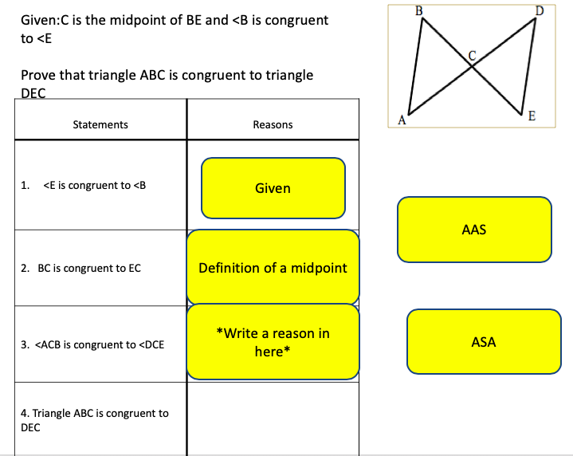
Instructions
Label the given information on the diagram on your worksheet!
Drag and drop the Statements and reasons to complete the proofs
Check in with your teacher when you see the stop sign

Slide 3
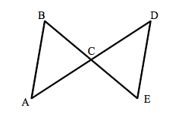
Proof 1: Label the givens and things that you can prove on your worksheet
Given: AC = DC and AB//DE
Prove: triangle BCA is congruent to triangle ECD
Statements | Reasons
AC = DC and AB//DE
2. <A = <D
3. <BCA = <ECD
4. Triangle BCA is congruent to triangle ECD
Vertical angles are congruent
Given
ASA
Alternate angles are congruent
AAS
Corresponding angles are congruent

Slide 4
Proof 2: Label the givens and things that you can prove on your worksheet
Given: BE and AD bisect each other
Prove: triangle BCA is congruent to triangle ECD
Statements | Reasons
BE and AD bisect each other
2. BC = EC and DC = AC
3. <BCA = <ECD
4. Triangle BCA is congruent to triangle ECD
Vertical angles are congruent
Given
AAS
Definition of a bisector
SAS
Corresponding angles are congruent

Slide 5
Proof 3: Label the givens and things that you can prove on your worksheet
Given: RV is the perpendicular bisector of ST
Prove: triangle RVS is congruent to triangle RVT
Statements | Reasons
RV is the perpendicular bisector of ST
2. RV = RV
3. <RVS = <RVT
4. SV = TV
5. triangle RVS is congruent to triangle RVT
R
Shared side
S
T
Given
V
RHL
Definition of a bisector
SAS
Perpendicular lines form congruent right angles
ASA
Vertical angles

Slide 6
Proof 4: Label the givens and things that you can prove on your worksheet
Given: RV bisects <SRT and <S = <T
Prove: triangle RVS is congruent to triangle RVT
Statements | Reasons
RV bisects <SRT
2. <S =<T
3. RV = RV
4. <SRV = <TRV
5. triangle RVS is congruent to triangle RVT
R
Shared side
Given
Given
S
T
V
RHL
Definition of a bisector
AAS
Perpendicular lines form congruent right angles
ASA
Vertical angles

Slide 7
Time to compare with the person next to you
If you disagree with any, or are unsure, check in with a teacher
NEXT: You will now have some blank tiles you will need to fill in yourself
“Fill in your own statement”
“Fill in your own reason”

Slide 8
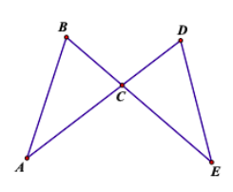
Proof 5: Label the givens and things that you can prove on your worksheet
Given: BC = DC and <EDC = <ABC
Prove: Triangle ABC = Triangle EDC
Statements | Reasons
RV bisects <SRT
2. BC = DC
3. <BCA = < DCA
4. Triangle ABC is congruent to triangle EDC
Shared Angle
Enter your own statement here
Given
Given
AAS
Definition of a bisector
Enter your own reason here
SAS
alternate interior angles
ASA
Corresponding angles

Slide 9
Proof 6: Label the givens and things that you can prove on your worksheet
Given: BC = DC and EC = AC
Prove: Triangle ABC = Triangle EDC
Statements | Reasons
EC = AC
2. BC = DC
3. <BCA = < DCA
Shared Angle
Given
Given
AAS
Definition of a bisector
Enter your own reason here
SAS
alternate interior angles
Enter your own statement here
ASA
Corresponding angles

Slide 10
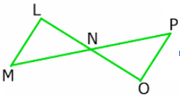
Proof 7: Label the givens and things that you can prove on your worksheet
Given: LO and PM bisect each other
Prove: Triangle LNM = Triangle ONP
Statements | Reasons
LO and PM bisect each other
2. LN = ON and PN = MN
3. <LNM = <ONP
4. Triangle ABC is congruent to triangle EDC
Vertical angles are congruent
Given
Given
AAS
Enter your own statement here
Definition of a bisector
SAS
Enter your own reason here
alternate interior angles
ASA
Corresponding angles

Slide 11
Proof 8: Label the givens and things that you can prove on your worksheet
Given: LM // OP and LO bisects PM
Prove: Triangle LNM = Triangle ONP
Statements | Reasons
LO bisects PM and LM//OP
2. <M = <P and <L = <P
3. <LNM = <ONP
4
Vertical angles are congruent
Given
Enter your own reason here
Given
AAS
Definition of a bisector
SAS
Enter your own statement here
ASA
Corresponding angles

Slide 12
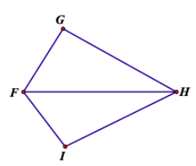
Proof 9: Label the givens and things that you can prove on your worksheet
Given:<G = <I and FH bisects <GFI
Prove: triangle IFH = GFH
Statements | Reasons
<G = <I
2. FH bisects <GFI
3. FH = FH
4
5. Triangle IFH = Triangle GFH
Shared side
Given
Given
Enter your own statement here
Definition of a bisector
SAS
AAS
Enter your own reason here
ASA
Corresponding angles

Slide 13
Proof 9: Label the givens and things that you can prove on your worksheet
Given: FH bisects <GFI and <GHI
Prove: triangle IFH = GFH
Statements | Reasons
FH bisects <GFI and <GHI
2. <GFH = <IFH
3. <GHF = <IHF
4
5. Triangle IFH = Triangle GFH
Shared side
Given
Given
Enter your own statement here
Definition of a bisector
SAS
AAS
Enter your own reason here
ASA
Corresponding angles

Slide 14
Time to check in! How did you do?
Collect the paper proofs from your teacher
You can save your powerpoint to go through with your teacher
If you have time remaining you can start tonight’s homework on Edpuzzle

